Slide 1



X
#DOWELLDOGOOD
Internal Only

Slide 2
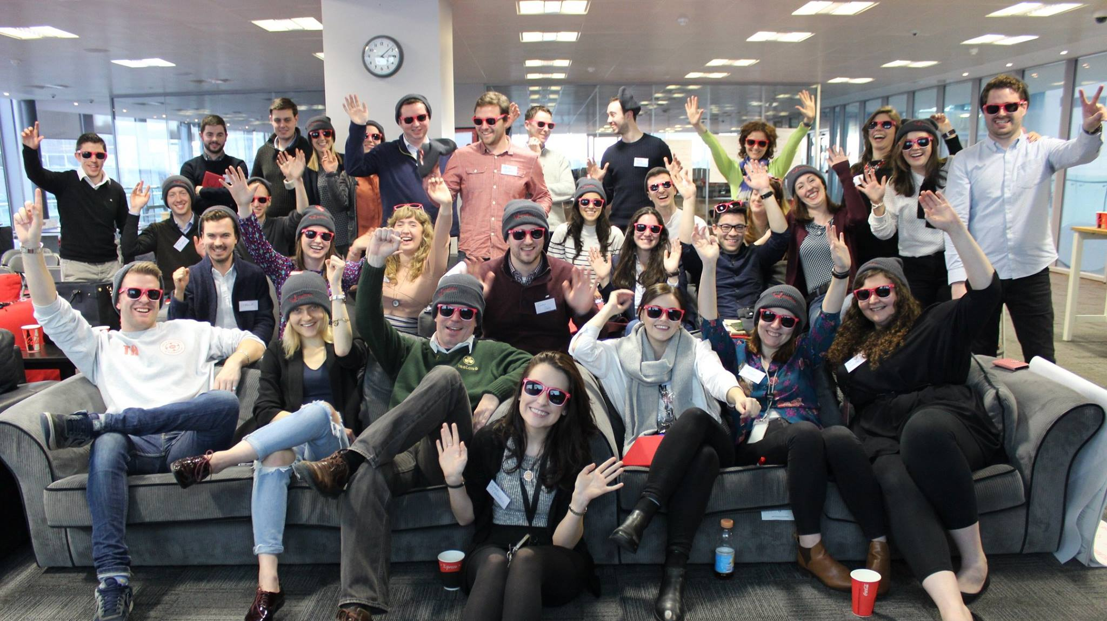
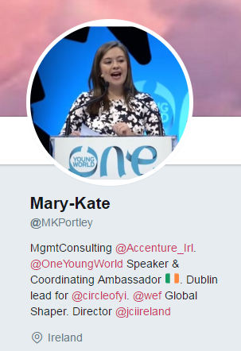


#DOWELLDOGOOD
/marykateportley
@MKPortley
@CircleOfYI
Notes:
Your background
How did you hear about the Circle?
Why did you join?

Slide 3
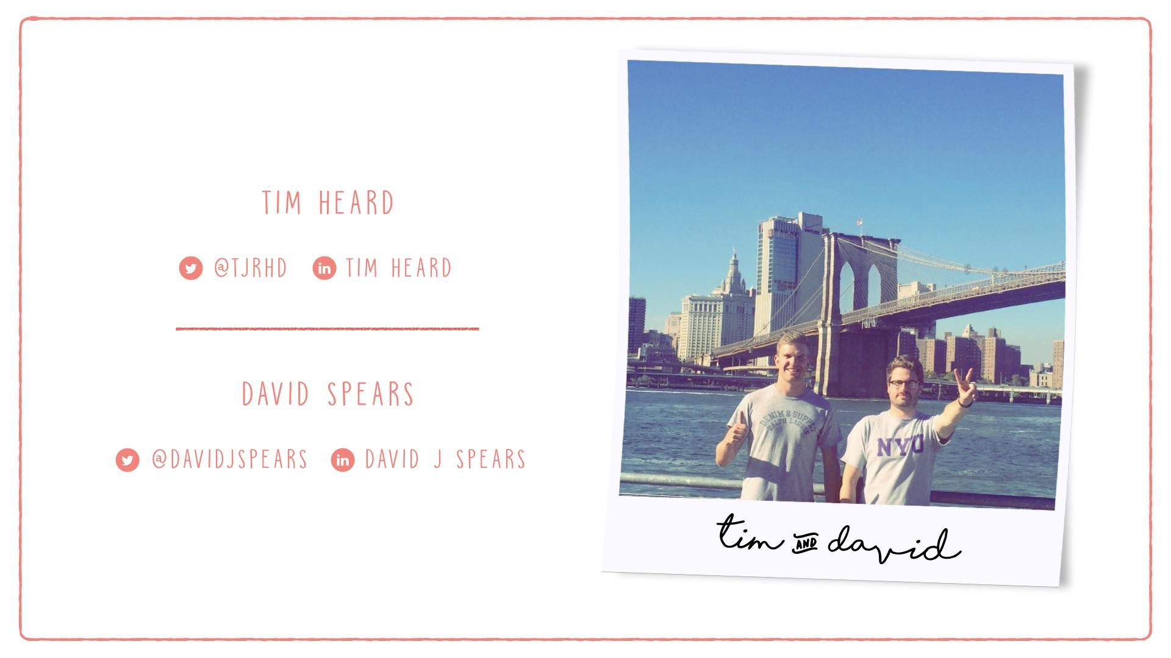
Notes:
Co-Founders
Their journey of Barclays and roundup – how the circle came about

Slide 4
Agenda
WHAT IS (SOCIAL) INTRAPRENEURSHIP?
WHO ARE THE CIRCLE OF YOUNG INTRAPRENEURS?
WHY IS (SOCIAL) INTRAPRENEURSHIP IMPORTANT?
HOW TO DELIVER PURPOSE DRIVEN PROJECTS
Case Studies: Accenture ADP and Barclays RoundUp
Challenges of Delivery: How can you achieve this within the “Big Machine”
Q&A

Slide 5
WHAT IS SOCIAL INTRAPRENEURSHIP?
Internal Only

Slide 6
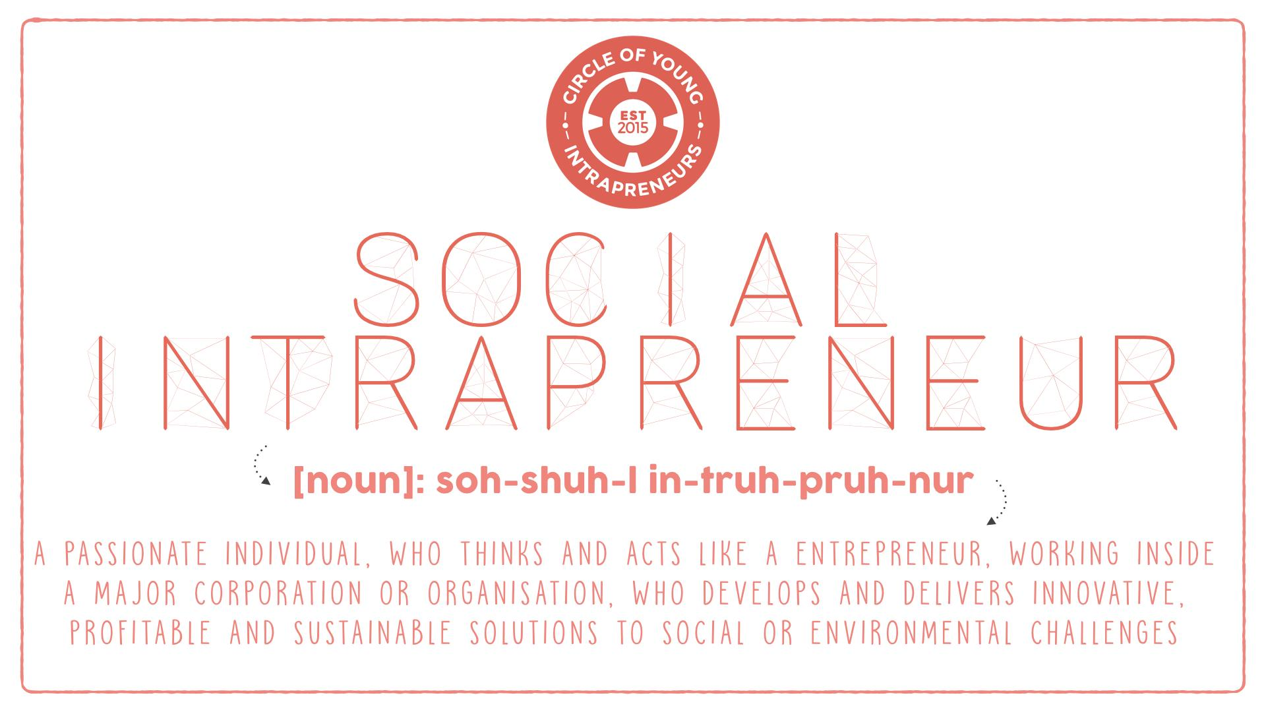
Notes:
This is our own definition of social intrepreneur
Essentially it is entrepreneurial minded people within corporate that want to make business a force for good, they act above and beyond their day job to use business to profitably solve social problems
Analogy of the “Oil Tanker”
Gib Bulloch from Accenture discusses this idea. How do you turn a huge oil tanker? A 1% shift of direction makes a massive difference in trajectory
Intrapreneurship is bottom-up rather than top down, which brings delivery challenges
COYI aims to create a network of corporate change-makers, who can come together to share their ideas, projects and challenges

Slide 7
WHO ARE THE CIRCLE OF YOUNG INTRAPRENEURS?
Internal Only

Slide 8
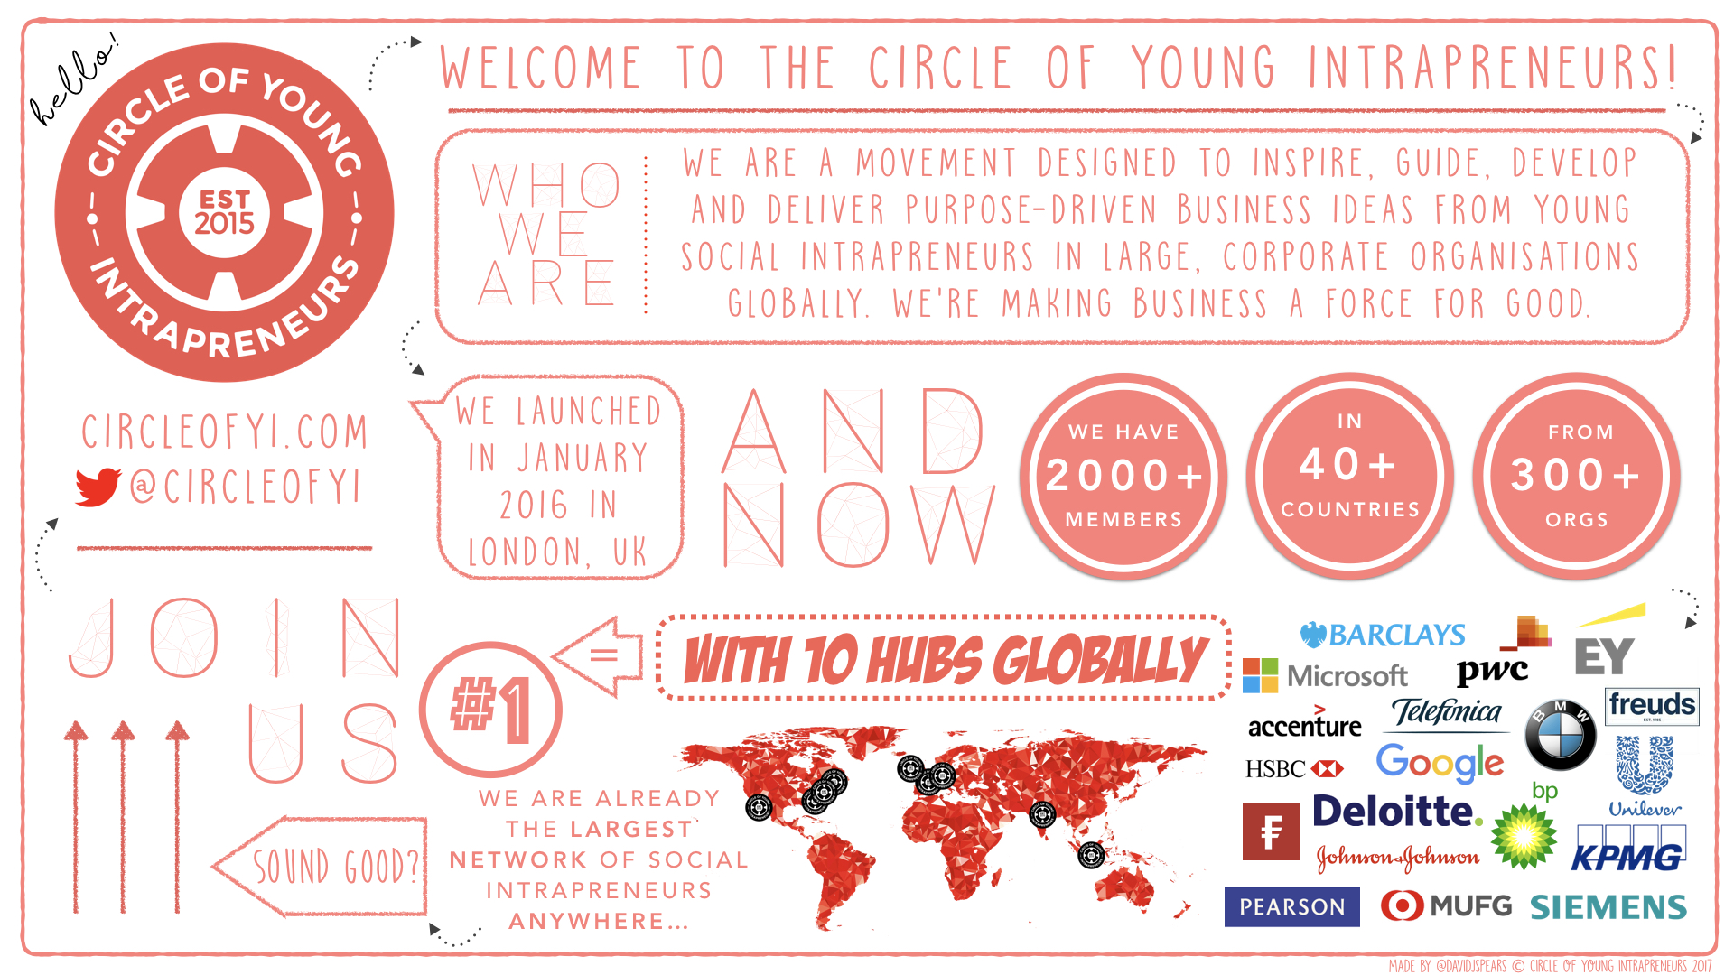
Notes:
Overview of the circle
Number of members / companies / countries involved
Started in London with 8 people and in 18 months it now has 2000 + members
The message resonates with young employees
Soon to open on our 4th continent with South Africa
Big companies are struggling to keep talent, and the best talent are the most socially conscious ones

Slide 9
WHY IS SOCIAL INTRAPRENEURSHIP IMPORTANT?

Slide 10


INDIVIDUALS
SOCIETY
DEVELOPMENT: DO WELL
PURPOSE
VALUE
MEANING
IMPACT: DO GOOD
SHIFT THE ‘OIL TANKER’
SUSTAINABILITY
WORKING CULTURE
Notes:
Individual Development: Do Well – if you only do well, will you be happy? You develop by integrating with a more senior network, pitching to them, understanding how they work, interacting with the top people in your organisation. Opens you up to opportunities that you not have previously had. The Millennial workforce in particular wants their life and their career to have purpose, meaning and value and intrapreneurship allows them to go to work with a purpose greater than themselves, feel valued and listened to by senior management and create meaning for their career.
Society: The oil tanker analogy – the amazing impact this inward innovation can have by leveraging the power of corporates. The is not CSR. CSR is not sustainable. Intrapreneurship is companies saying lets make our products and services impactful, but lets profit from them. Our company can do well, and we can do good for society. Overall, it creates a better working culture. Suicide is the leading cause of death of young men in Ireland. If people are worked to the bone, they feel they have no purpose or meaning day to day, that is not healthy. Accenture has initiatives to counter-act this, the new Thrive approach with Ariana Huffington, being Truly Human. Rather than launching initiatives to counter-act overwork, we should be doing more initiatives like this one today where employees can make their day to day more purposeful and connect them to the wider world and the bigger picture.

Slide 11
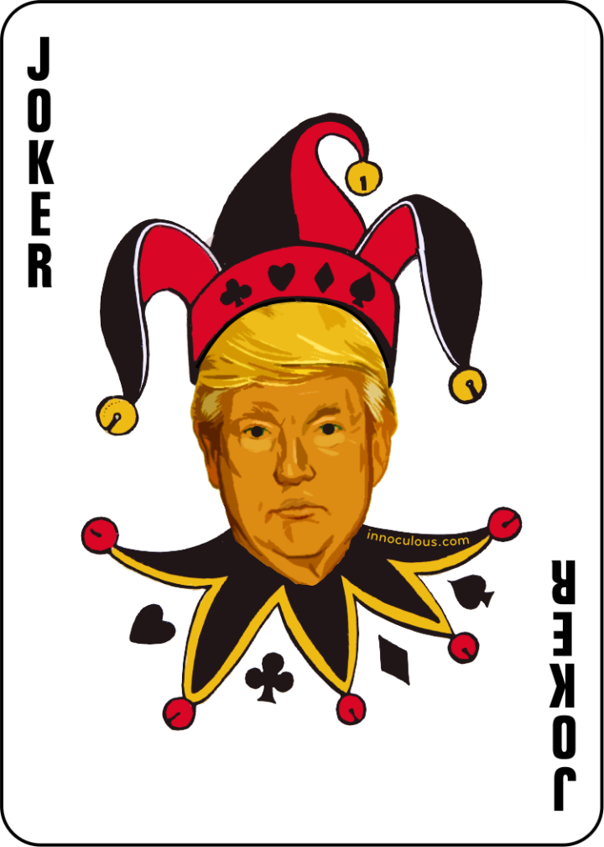
THE TRUMP CARD – WHY SOCIAL INTRAPRENEURSHIP IS IMPORTANT TO CORPORATES
Talent Management
Leadership Development
Innovation Trajectory
Reputation & Brand
Growth
Notes:
The “Business Case” of Intraprenruship
You are going into clients or speaking to MDs and you want to bring in this new, innovative approach to how you work.
People will ask WHY? And What’s in it for me (WIFFIM)? It is normal for business to want to know why they should invest in something before doing so….. And there are 5 categories on how we can show that intrapreneurship is important to corporates.
Talent Management: Daniel Pink has a talk called “drive” which is available on YouTube that goes into more detail on this, Intrapreneurship is a talent management dream – it attracts and retains top talent, it also allows top talent to be best utilised by the company by allowing them to excel and work outside normal constraints.
Leadership Development: The most effective leaders have the mindset of an entrepreneur. 80% of entrepreneurs left their company to start their own because they felt stifled by the corporate structure.
Innovation Trajectory: The entire company should be innovators, not the “Head of Innovation”, or just the innovation team, everyone has the opportunity to innovate. I firmly believe that a company can only be truly innovative when everyone from the newest member of staff to the CEO has the opportunity to pitch and progress ideas that can turn profit for the company.
Reputation and Brand: Unilever is king here, their sustainability report proved that they make more money from their products that are marketed as sustainable. They make more profit
Growth: The World Economic Forum has quantified the circular economy at 12 trillion dollars. Corporates can get a slice of that pie. Furthermore, by employing intrapreneruship companies can not only increase their market share, but also break into a whole new market.
In short, this is a better way of doing business because you are future-proofing the company

Slide 12
HOW TO DELIVER PURPOSE-DRIVEN PROJECTS: CASE STUDIES

Slide 13
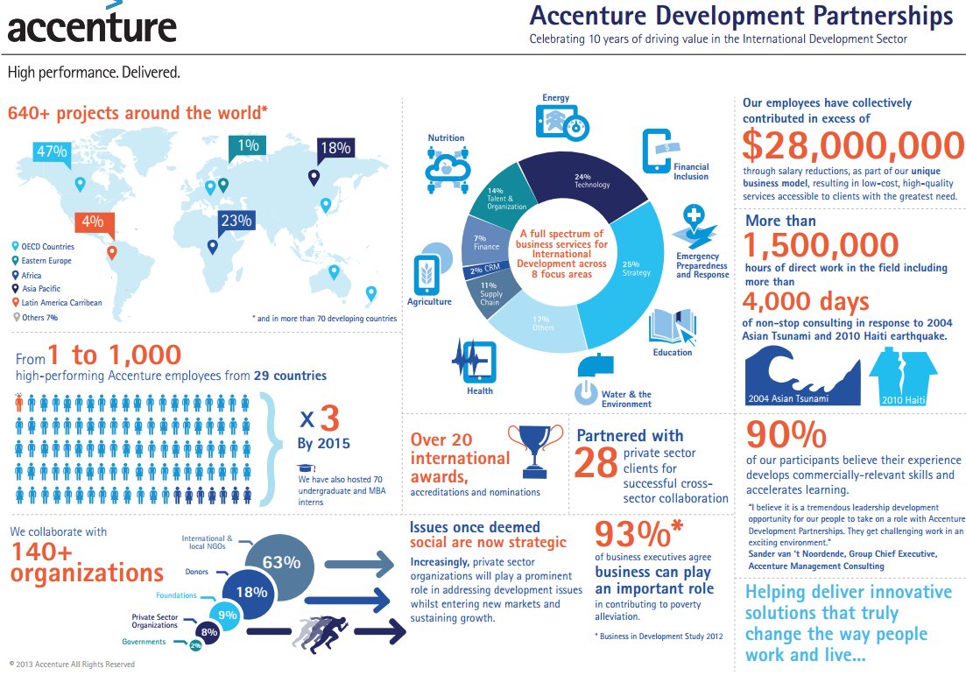
Notes:
Accenture has been a pioneer in this space, with the creation of Accenture Development Partnerships (ADP). Gib Bulloch saw so many young consultants leaving the company to join NGOs because they wanted to do more to contribute to the world and felt they couldn’t get the same hands-on feeling within Accenture. ADP is essentially a NGO within Accenture that give consultants the opportunity to take a reduced pay and consult for non-profits or foreign governments. I see the increased in popularity of intrapreneurship as a way to bring Gib’s idea to the next level, by finding a way to not just do this internally but to ideate as to how we can do this with our clients too.

Slide 14

Barclays RoundUp
A collaboration between the Barclays Internal Intrapreneur Challenge 2015 winner and Bstow (Barclays Accelerator Tel Aviv)

Slide 15

Barclays RoundUp is a collaborative micro-donation initiative that facilitates a virtuous cycle amongst users, charities and Barclays
Overview
Barclays RoundUp will provide the following features:
Our users can opt in to automatically round up every purchase by a few pennies
Funds go towards customer’s choice of social impact portfolio
Support an intuitive customer journey with no change required in customer purchasing behaviour
Win, Win, Win
Doing good, profitably, in a way that’s convenient & simple for our customers
WIN
Opportunity to integrate “do good” with everyday purchases and lifestyle
Enables customers to explore meaningful and impactful ways to spend spare change
Opportunity to expand to separate channels e.g. savings and investments
Customers
WIN
WIN
Potential to raise £millions for good causes at scale
Opportunity to develop relationships with customers and Barclays for further engagements
Opportunity to delight customers whilst achieving our 5C’s objectives
Potential to drive key financial benefits at minimal cost
Millennial engagement
Society
Barclays
Notes:
Intrapreneurial projects must have a win-win-win mentality.
You need to be providing a product / service that is in demand by the consumer, that turns a profit and that solves a social problem.
Barclays have achieved this by bringing micro-donations to their Barclayscard.
Barclays engage Millennials by appealing to their purpose-driven consumer behavior, Barclays take a percentage of each transction and also see an increase use of the Barclayscard, the consumer feels that their spare change and their purchases are leading to meaningful impact through the scheme, millions of pounds for good causes are raised

Slide 16
Even if only a fraction of current Barclays users adopt RoundUp the social impact would be very significant
Significant financial impact even with minimal adoption rate
Charities currently suffer a ‘donation gap’ and are underfunded
c23m
X
5%
X
£5
=
£69M
Current Active Card Customers in Barclays UK
Average Round-up per month per user
Total donation per annum
Adoption Rate
Annual Collaborative Donation to Social Enterprises
Average RoundUp per user per Month | Adoption Rate
 | 1% | 2% | 5% | 10%
£1 | £2,760,000 | £5,520,000 | £13,800,000 | £27,600,000
£2 | £5,520,000 | £11,040,000 | £27,600,000 | £55,200,000
£5 | £13,800,000 | £27,600,000 | £69,000,000 | £138,000,000
Notes:
Figures above show that even a small adoption rate can have a significant impact – proof of the “shifting the oil tanker” theory.
If only 2% of the 23 million Barclaycard holders opt in to the scheme, with an average donated of 5 pound a month that will create almost 70 million pounds in 1 year.

Slide 17












RoundUp – Final Model
2
1
User signs up with RoundUp and has opted to support a portfolio Fighting Poverty in Africa
After making a payment on a RoundUp enabled card, funds are sent to a dynamic impact portfolio comprised of both social enterprises and charities
Fighting Poverty in Africa Portfolio
3
Qualitative and quantitative feedback on the performance of each Dynamic Impact Portfolio organization is collected
Clean Water
Food
Shelter
4
Regular feedback will be sent to a the user’s mobile phone and will incentivise them to keep giving
Quantitative Feedback
Qualitative Feedback
Feedback on Social Impact
Notes:
High level customer journey

Slide 18
HOW TO DELIVER PURPOSE-DRIVEN PROJECTS: THE “BIG MACHINE”

Slide 19
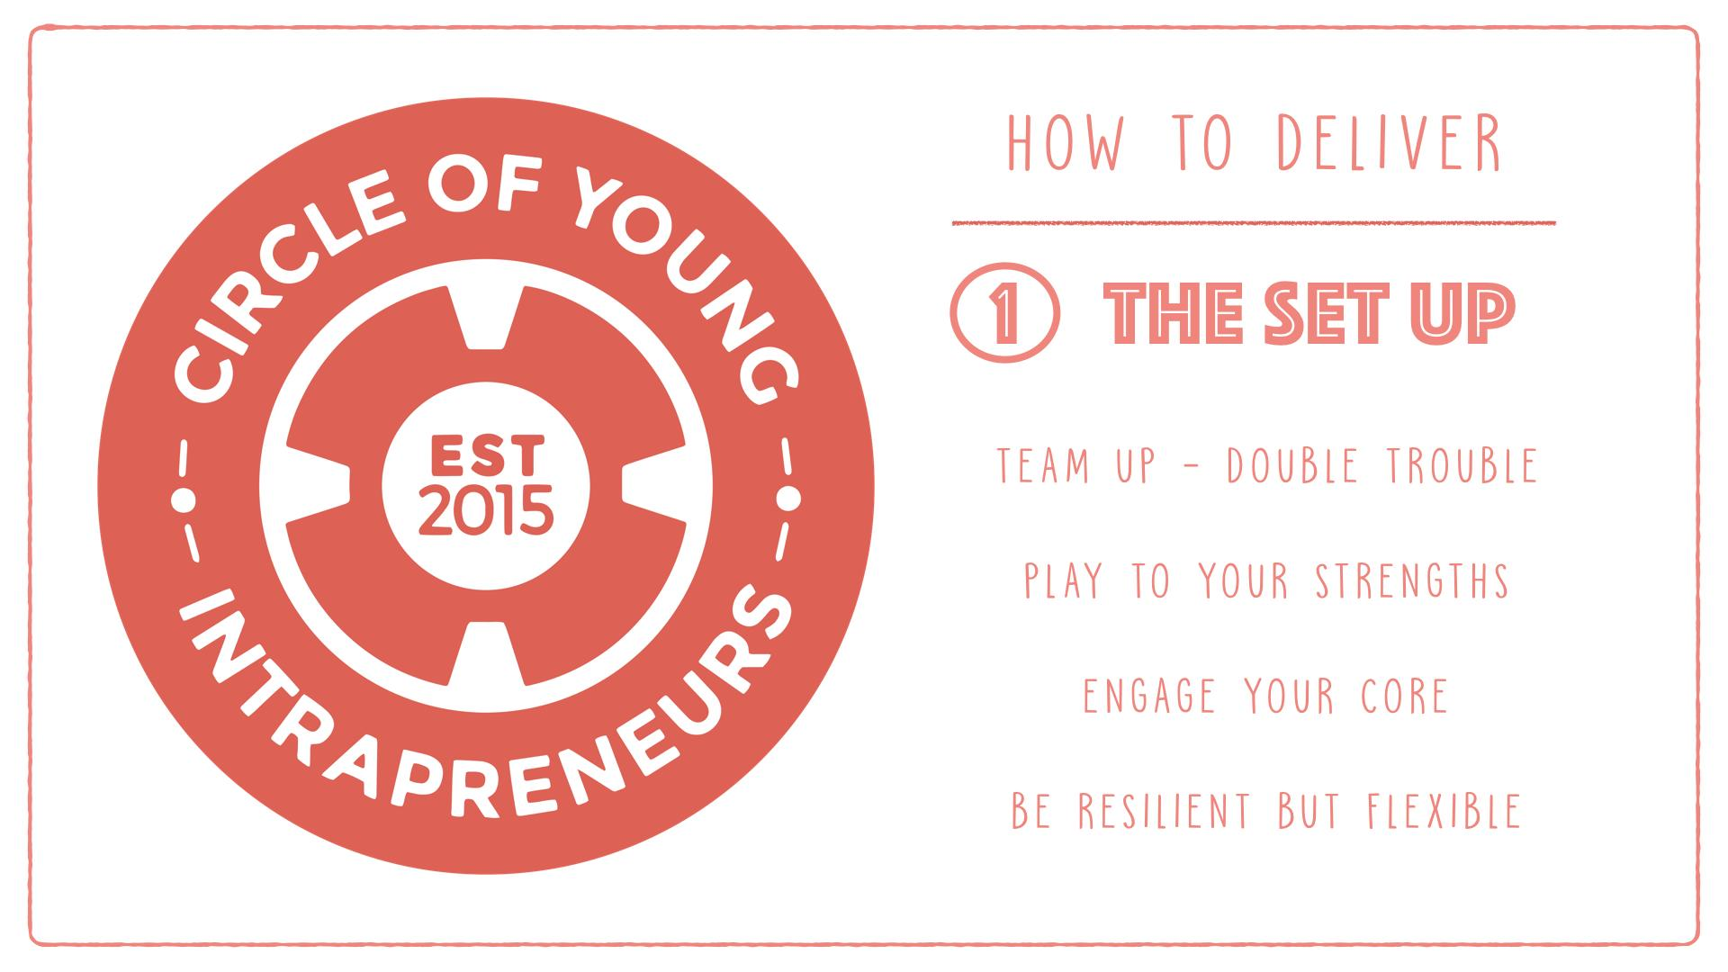
Notes:
Team Up: its easier to go through the journey when you have someone there with you. Tim and David
Paly to your strengths: Tim and David are very different, each has their own niche and that compliments one another
Engage your core: Bring your manager on the journey with you. What starts off as “side of desk” might later become delivery, so its important that you take your team and managers with you
Be resilient but flexible: Know what you cannot compromise on, but be open to hearing other workarounds too

Slide 20
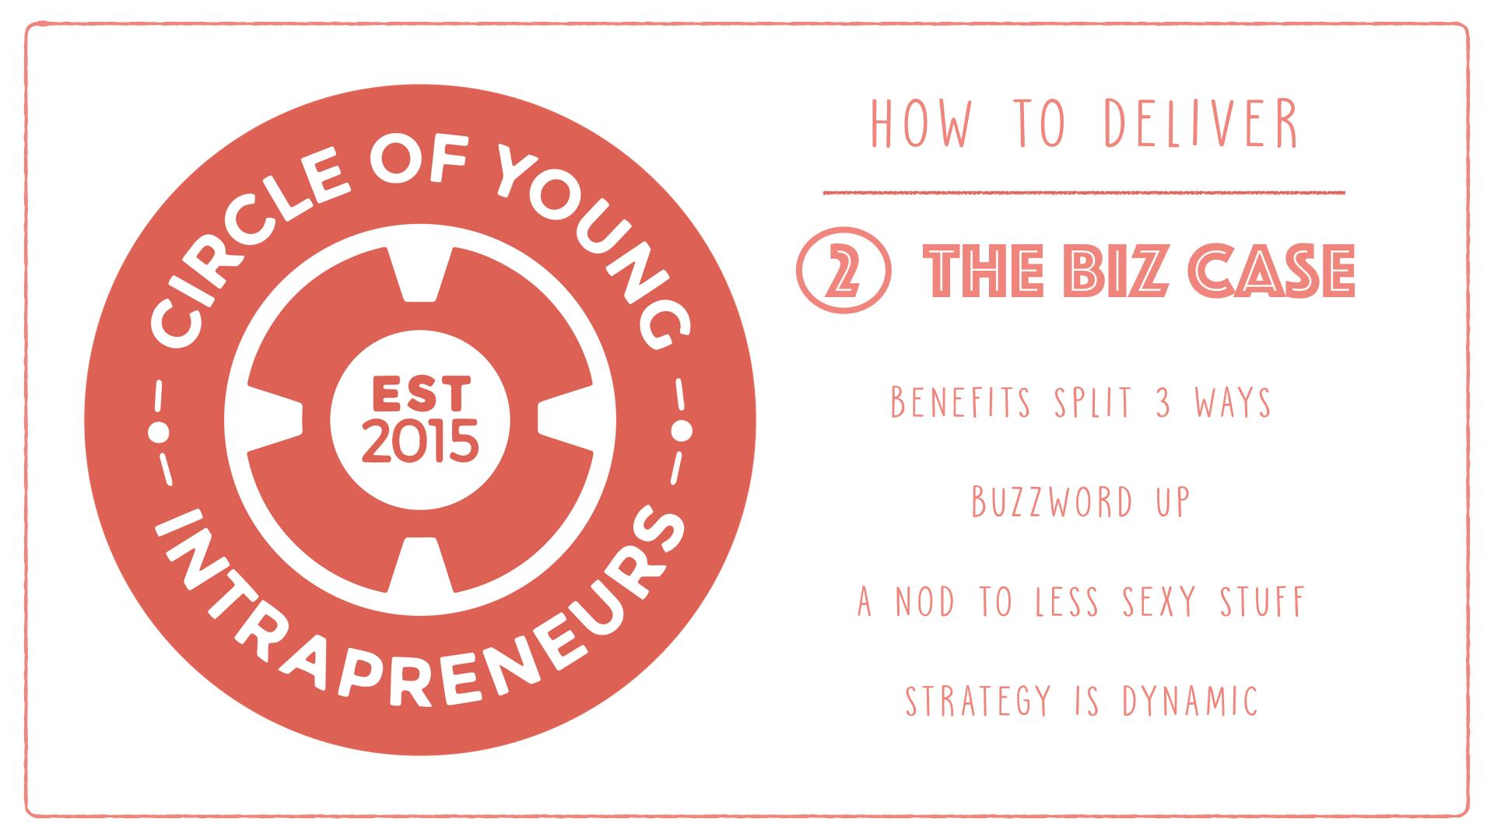
Notes:
Benefits split 3 ways: Win-Win-Win mentality needs to flow through everything
Buzzword up: Leaders are readers!
A nod to the less sexy stuff: Setting up, dotting I’s and crossing T’s still needs to be done
Strategy is dynamic: What is your company or your client’s strategy – globally or locally. How is your project fulfilling this strategic vision e.g. Accentures Global Retail Strategy is all about bringing companies to understand the new purpose-driven consumer, locally in Ireland we want to create mini-thought leaders etc.

Slide 21

Notes:
Face time: get in front of people, speak with them, get a coffee. E-mail wont cut it when youre trying to drive bottom up change
Power of the PA: Works everytime. Direct emails to leadership – no matter how well you think you know them – wont fly. Get onto the PA, its had a 100% success rate.
Create cheerleaders: Like a sponsor, someone to mentor and guide you and when things get tricky, to give you a little corporate cuddle.
Play Politics: This is the big machine we are tweaking, sometimes you need to play by their rules to get things pushed through

Slide 22
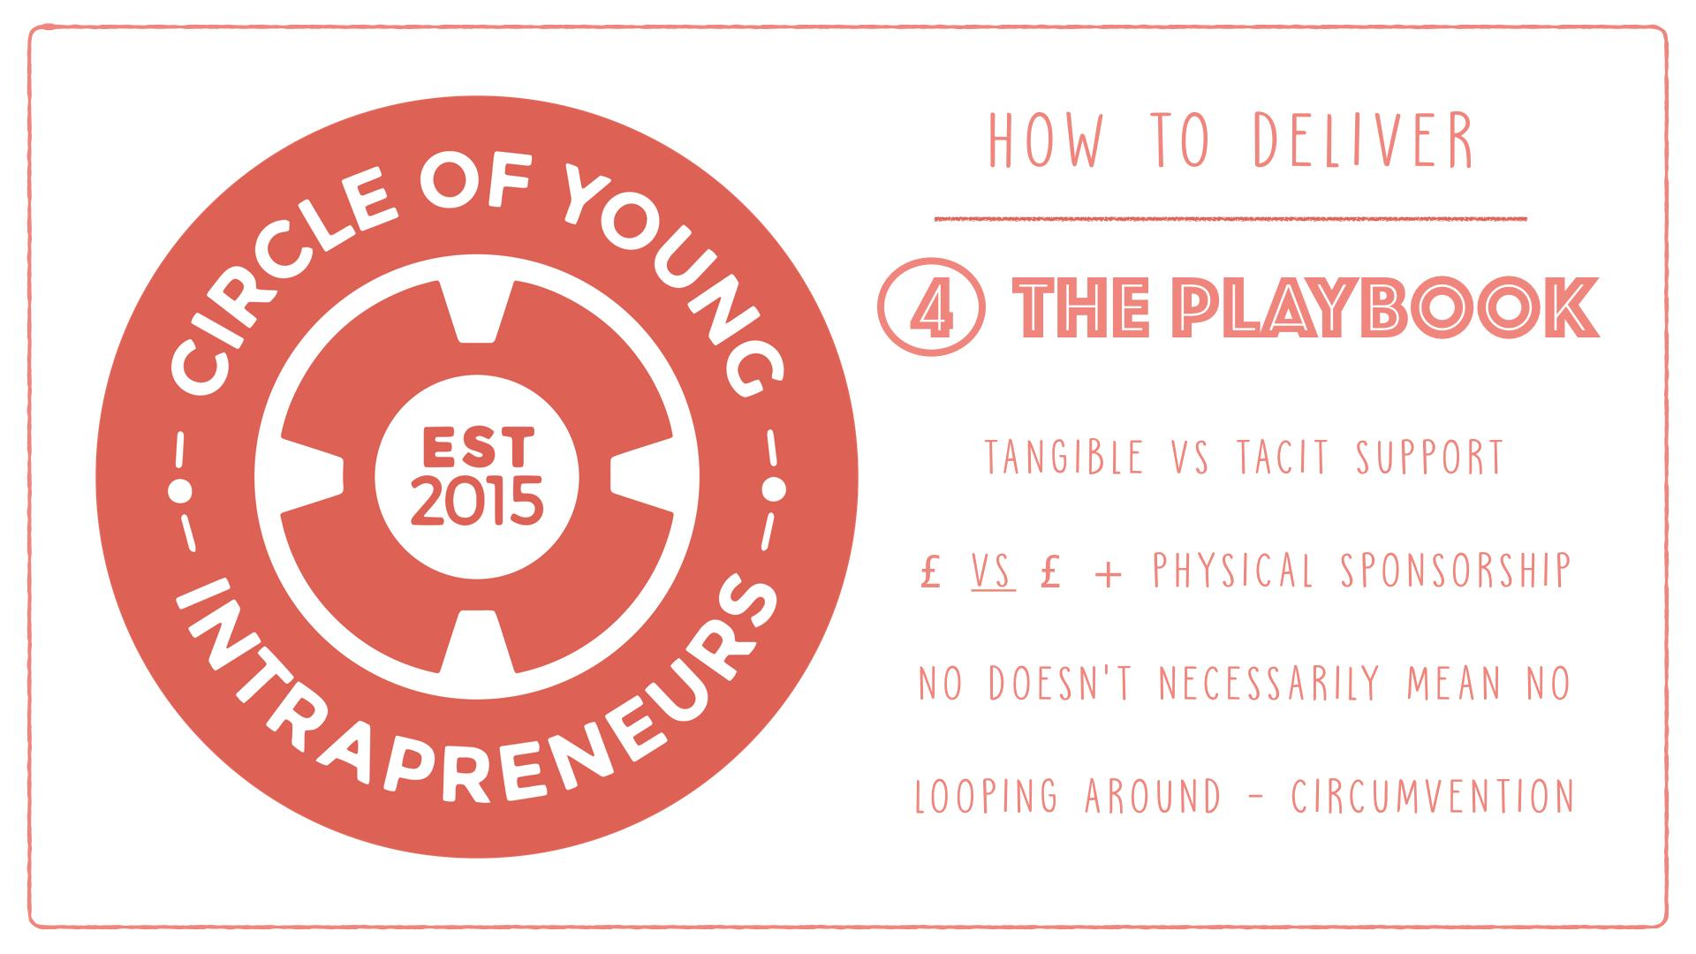
Notes:
Tangible vs Tacit support: Beware the MD pat on the head. Ask for advice based on their experience, make the ask clear so they know what you are looking for and what action is required of them
£ vs £: Money alone is not enough, you need physical sponsorship, senior people backing you
No doesn’t always mean no: I get in trouble for this, and have gotten slapped on the wrist before, but sometimes you need to test the boundaries. E.g Barclayscard and Legal department
Looping around- as above

Slide 23

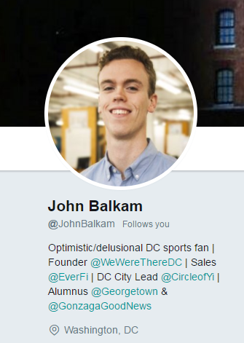
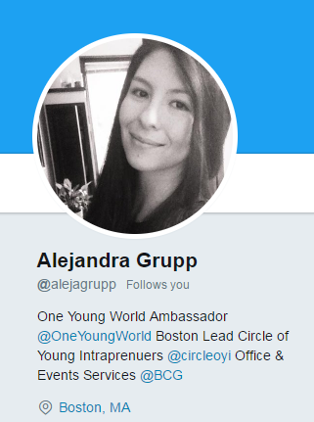
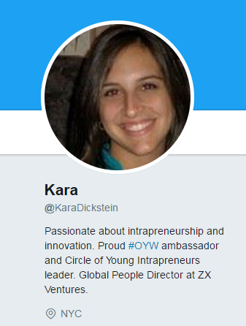
JOIN US – EAST COAST LEADS
WWW.CIRCLEOFYI.COM
@CIRCLEOFYI

